Slide 1
Practice of Computer Vision Lecture 3
TA: Wonjong Jang

Slide 2
Object detection
RCNN
Fast RCNN
Faster RCNN

Slide 3
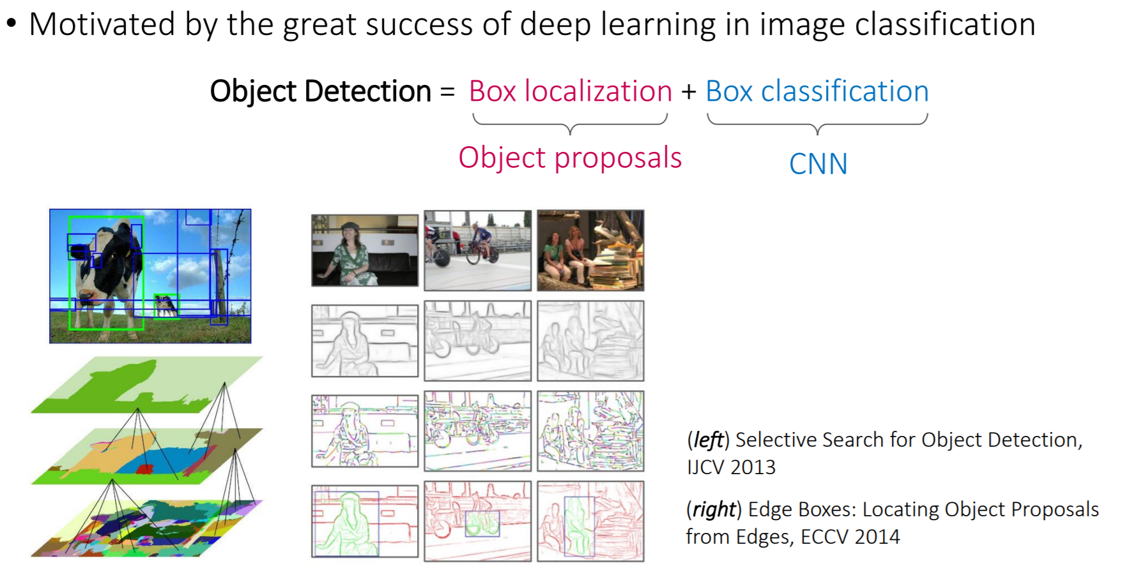
Object Detection: A Naïve Approach

Slide 4
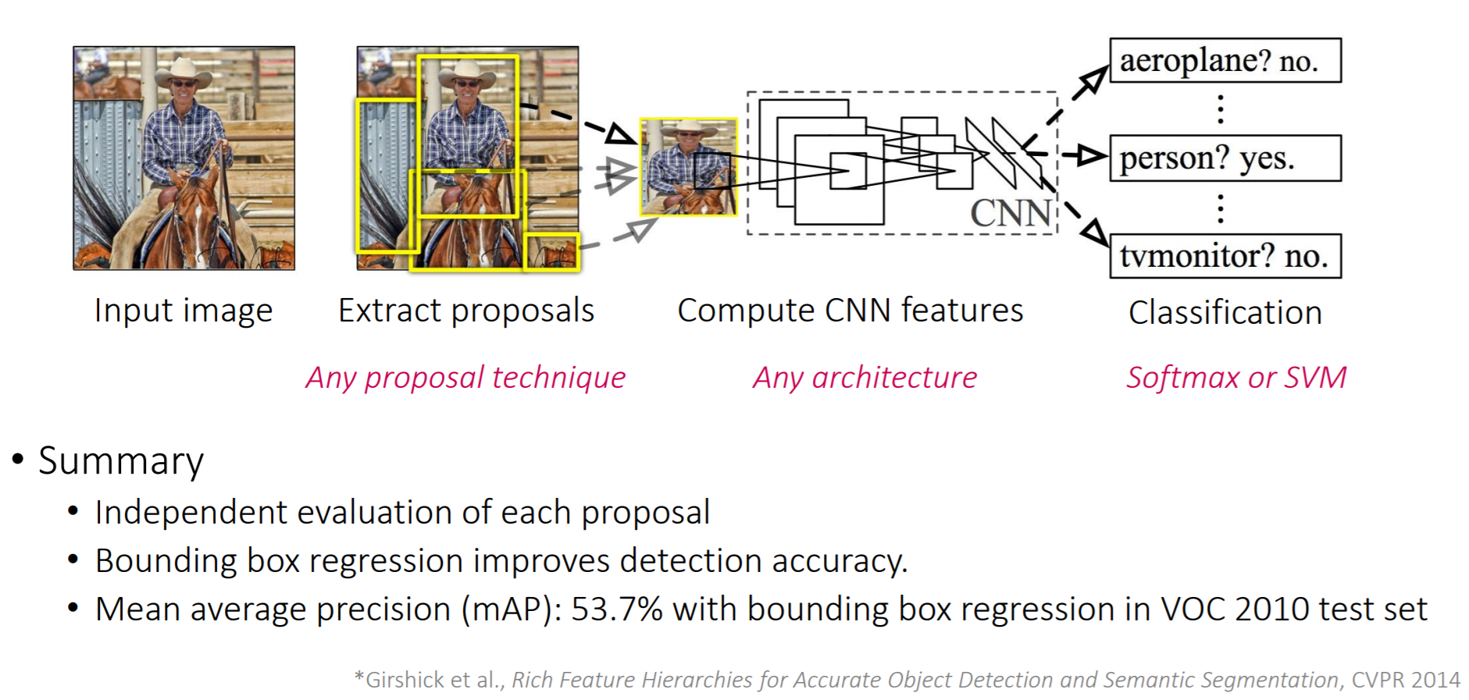
Region-based CNN (R-CNN)

Slide 5
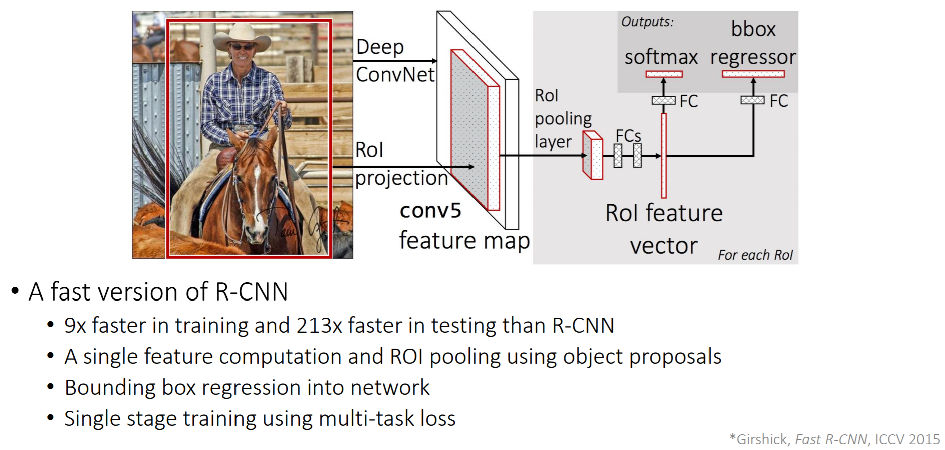
Fast R-CNN

Slide 6
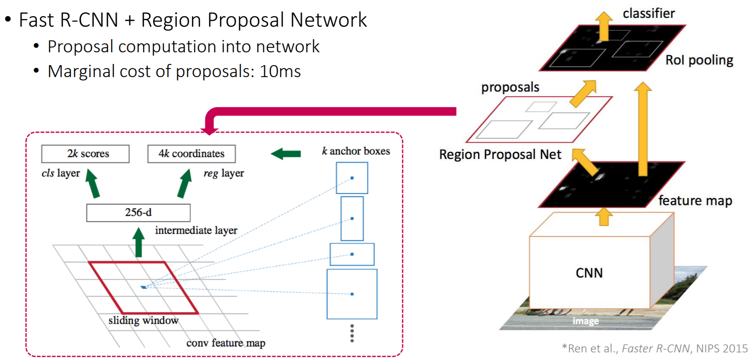
Faster R-CNN

Slide 7
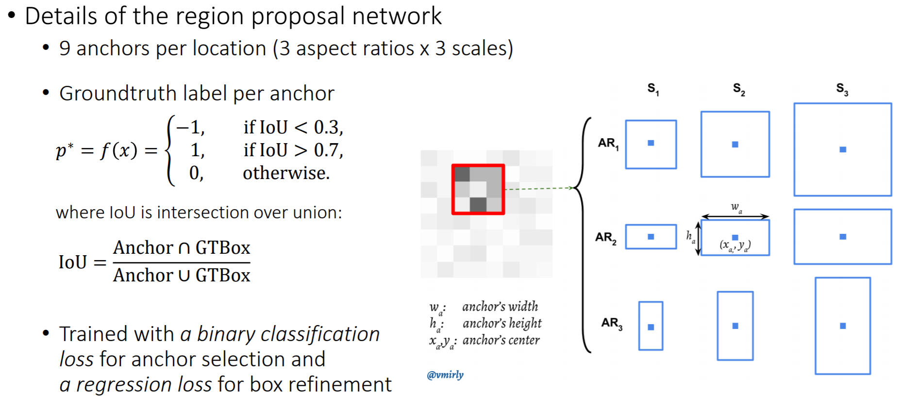
Faster R-CNN

Slide 8
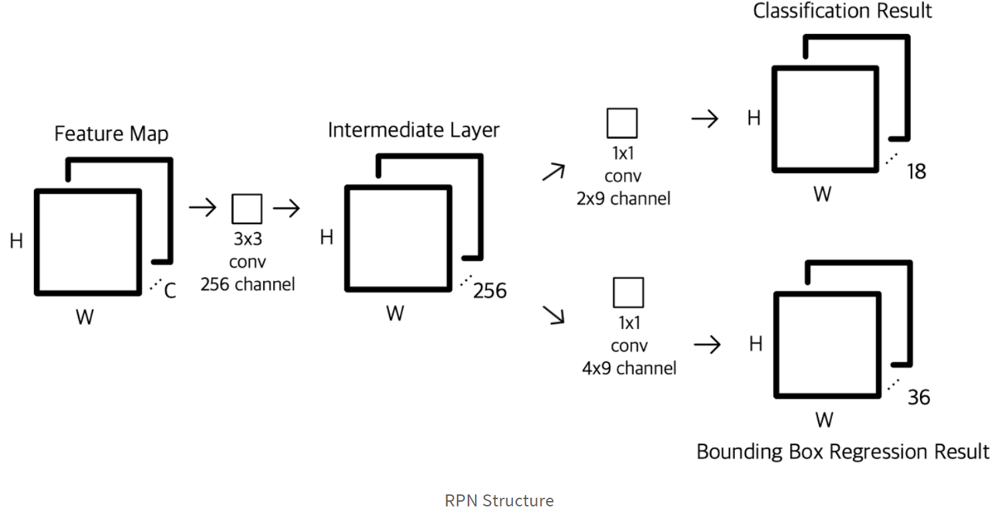
Faster R-CNN

Slide 9
Faster R-CNN
Summary of the process in Faster R-CNN
Image → (Feature extractor network) → Feature map → (Region Proposal Network) → Region Proposal
Feature map → (RoI pooling using Region Proposal) → RoI pooled feature map → (Classifier) → label
→ (Regreesor) → bbox

Slide 10
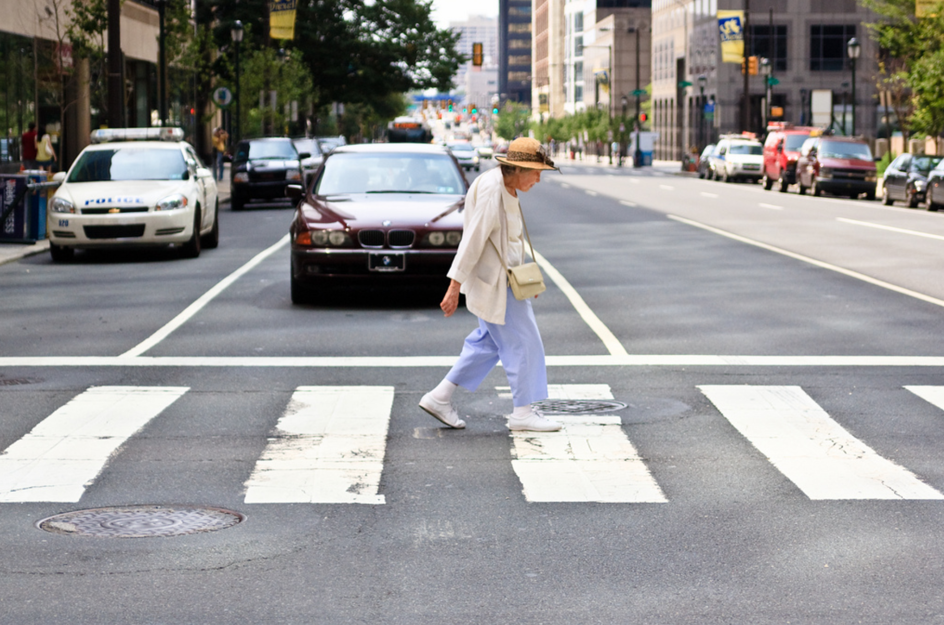
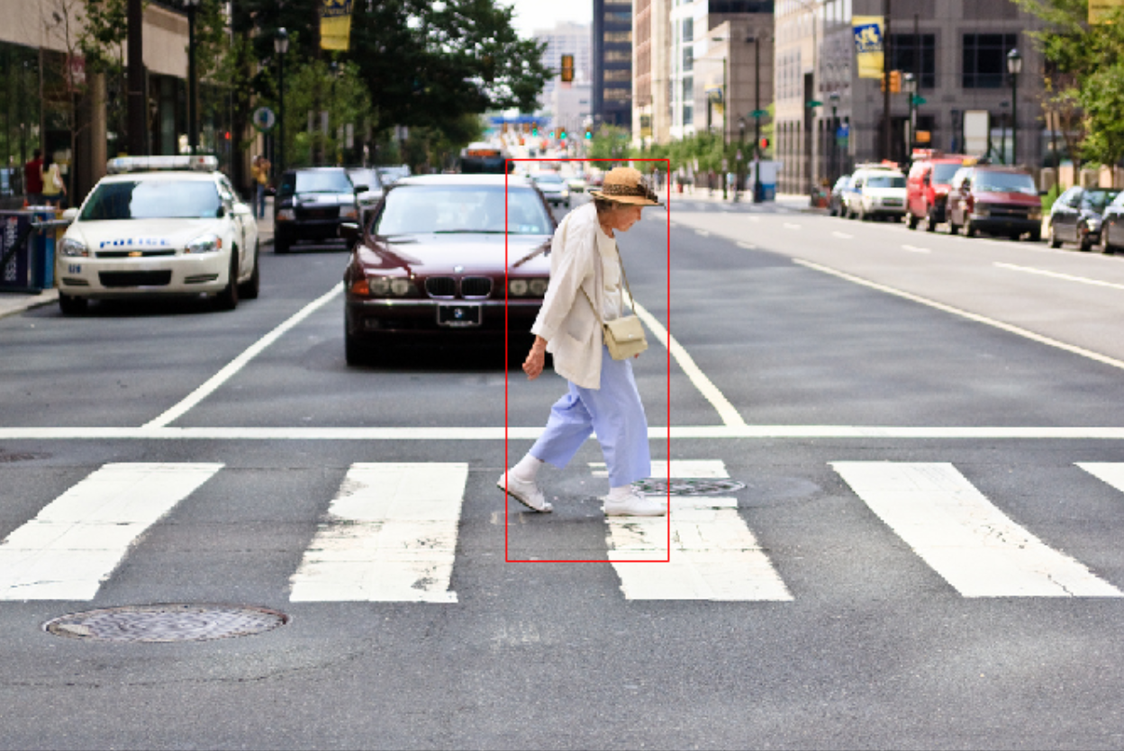
Faster R-CNN
Today’s practice - pedestrian detection

Slide 11
Thanks

